Slide 1
Welcome

Slide 2


Rayat Shikshan Sanstha’s
“Karmaveer Bhaurao Patil College of
Engineering, Satara”
Computer Engineering Department
Academic Year: 2022-23
Project Name:
“Tour Planning Website”

Slide 3
SUBMITTED BY:
Omkar Avaghade (ROLL NO. 2 )
Prasenjit Bhosale (ROLL NO. 11 )
Aniket Chavan (ROLL NO. 15 )
UNDER GUIDANCE : Prof. Vaibhav Bhosale
Prof. A.P. Kshirsagar
COMPUTER ENGINEERING DEPARTMENT

Slide 4
INTRODUCTION
There are definite rules laid out by authorities about driving cars on roads. The most common rule in any country is speed limit in certain roads i.e. you will be in violation of the law if your car speed exceeds this limit.
In order to detect the speed of a moving car, the patrolling officers usually depend on a handheld gun that works on Radar Technology or Lidar Technology. This is a tedious process as the officer has to manually check for over speeding for each vehicle.
What if the Car Speed Detection is made automatic? A simple automatic detection of speed of a vehicle is designed in Arduino Car Speed Detector project, where you can place the system in one place and view the results instantly without any human intervention.

Slide 5
CONTENT
INTRODUCTION
PLATFORM USED
COMPONENTS
CIRCUIT DIAGRAM
OBJECTIVES/AIM (Purpose of Project)
ADVANTAGES AND LIMITATIONS
CONCLUSION

Slide 6
PLATFORM USED
REQUIREMENTS:
React
Node.js
Mongo db
Stripe

Slide 7

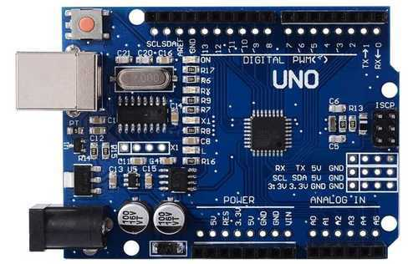
COMPONENTS
2. IR Sensor
Arduino Uno

Slide 8
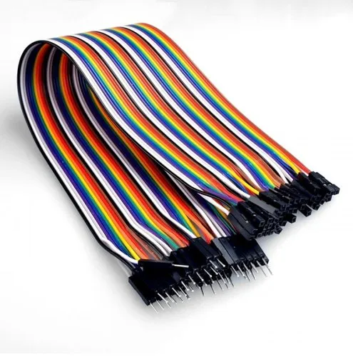

COMPONENTS
3. BREADBOARD
4. CONNECTING WIRES

Slide 9


COMPONENTS
6. 16 x 2 LCD DISPLAY
7. 9v BATTERY

Slide 10
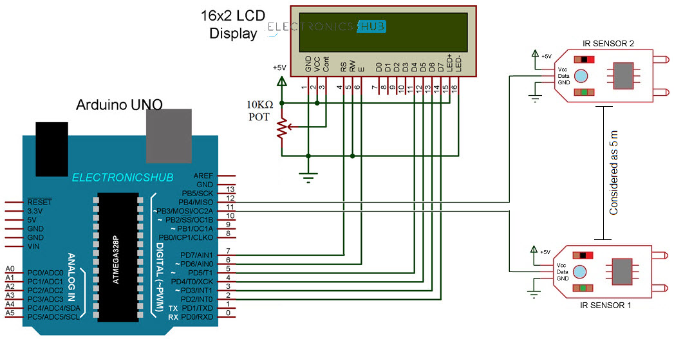
CIRCUIT DIAGRAM

Slide 11
OBJECTIVES / AIM
To design & develop Vehicle Speed detecting system using Arduino
Avoid over speeding and accidents
To keep the roads safe.

Slide 12
ADVANTAGES
Time and Cost Savings: Tours and travel websites allow travelers to compare prices and options easily, saving time and money in the process. These websites often offer exclusive deals and discounts, making it easier for users to plan their trips within their budget.
Easy Booking and Planning: With tours and travel websites, users can book flights, hotels, and activities quickly and easily, all in one place. This eliminates the need for users to navigate multiple websites or apps, streamlining the booking process.
Detailed Information: Tours and travel websites provide detailed information on destinations, hotels, and activities, making it easier for users to plan their trips. This includes reviews and ratings from other travelers, providing valuable insights and recommendations.
Customer Support: Tours and travel websites often provide 24/7 customer support, ensuring that users can get help and assistance whenever they need it. This provides peace of mind for users, knowing that they can get help if anything goes wrong.
Personalized Recommendations: Tours and travel websites can provide personalized recommendations based on the user's travel history and preferences. This makes it easier for users to discover new destinations and activities that they may not have considered before.

Slide 13
Limitations:
Dependence on Technology: Tours and travel websites rely heavily on technology, which can be a disadvantage if the technology fails or crashes. This can cause inconvenience and disruption to travelers who rely on the website for booking and planning their trips.
Lack of Personal Interaction: Online booking and planning may not provide the same level of personal interaction and support as traditional travel agencies. This can be a disadvantage for travelers who prefer personalized service or face-to-face interaction.
Limited Customization: While tours and travel websites offer a wide range of options for booking flights, hotels, and activities, there may be limited customization options available. This can be a disadvantage for travelers who have specific requirements or preferences.
Language and Cultural Barriers: Tours and travel websites may not always cater to the language and cultural needs of all travelers, which can be a disadvantage for those who do not speak the dominant language or are not familiar with the culture of the destination.
Trust Issues: With the rise of online fraud and scams, travelers may be hesitant to trust tours and travel websites, especially those that are not well-established or reputable.

Slide 14
Future Scope
Artificial Intelligence (AI) and Machine Learning (ML): AI and ML can help tours and travels websites provide personalized recommendations and suggestions based on the traveler's preferences and history. This can enhance the user experience and increase customer satisfaction.
Augmented Reality (AR) and Virtual Reality (VR): AR and VR can provide a more immersive and engaging travel experience, allowing travelers to explore destinations and activities before they book.
Blockchain Technology: Blockchain technology can provide a more secure and transparent booking and payment process, reducing the risk of fraud and ensuring privacy for travelers.
Internet of Things (IoT): IoT can provide real-time data and insights on travel, allowing tours and travels websites to provide more accurate and relevant information to travelers.
Sustainable Travel: As sustainable travel becomes a growing trend, tours and travels websites can promote eco-friendly destinations, activities, and accommodations, providing a more responsible and ethical travel experience.

Slide 15
CONCLUSION:
The moving vehicle detection, tracking and its speed measurement system is of great significance for present day transport system.
This iot project is focused on vehicle detection and tracking on single lane road and that in future it can be developed for multi –lane system.

Slide 16
THANK YOU

